Slide 1
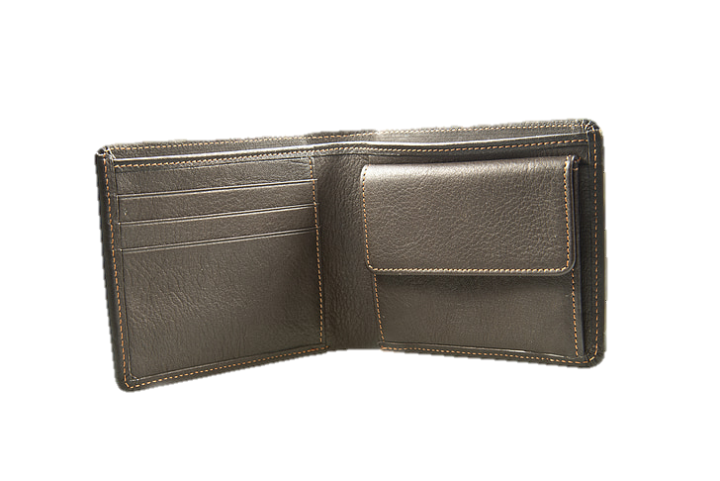

Slide 2


Slide 3





A theft-deterrent wallet that explodes when stolen to surprise and deter thieves.
Contains a GPS tracker to help locate the wallet if lost or stolen.
Compact and slim to fit easily in pockets or small bags.

Slide 4


Wallet theft is a common issue worldwide, leaving victims feeling helpless and losing valuable items.
“What if the thief couldn’t get away so easily?”
The Solution: A wallet that fights back, making theft more inconvenient than ever.

Slide 5
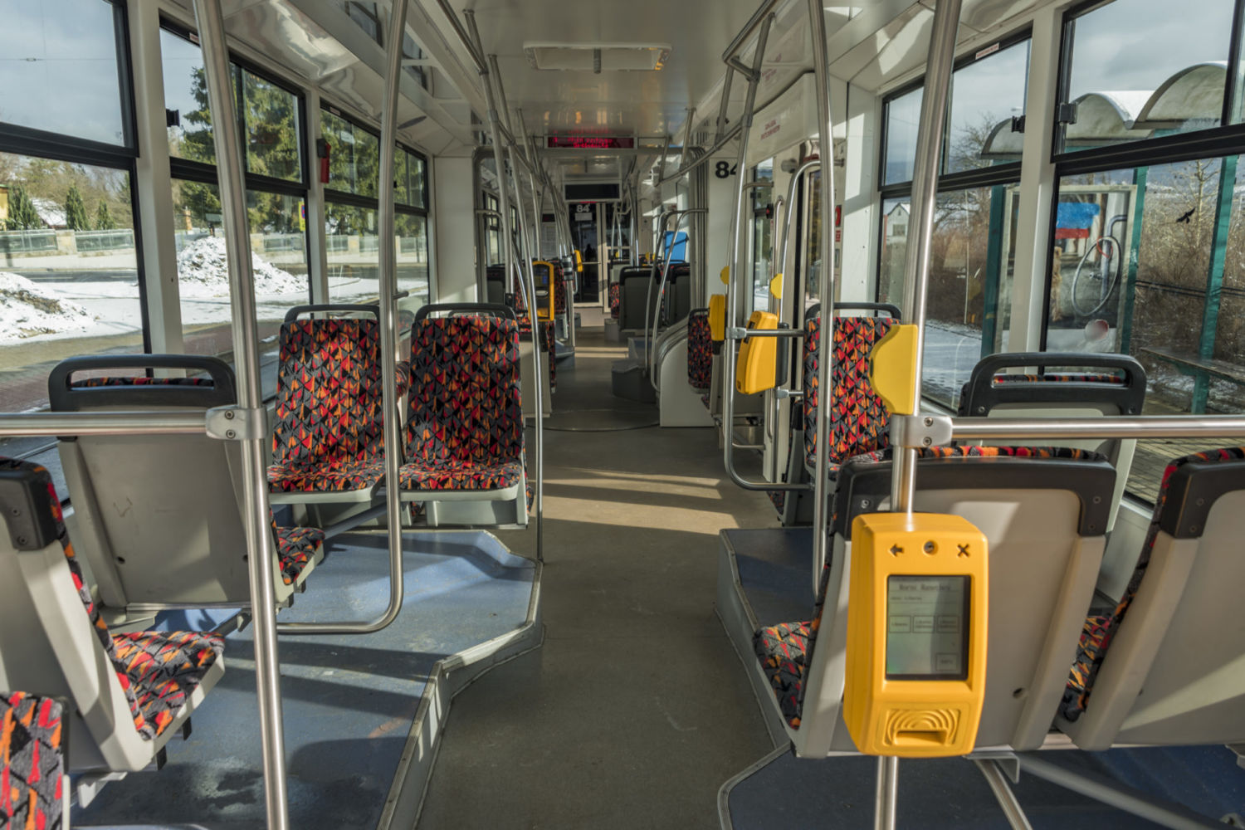



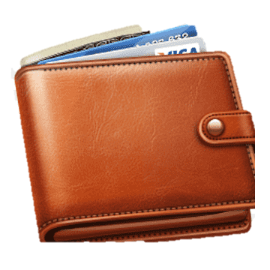


Slide 8


Slide 9



Slide 10


Slide 11


Wallet theft will decrease
You may be wanted by the police

Slide 12

Explosion is triggered remotely or automatically after a specific distance from the owner.
Smart integration with a mobile app to activate/deactivate the self-defense mode.
Battery life: up to 3 months per charge.
Built-in accelerometer to detect suspicious movement or unauthorized removal.

Slide 13

Professionals who carry important cards, cash, and IDs
Travelers concerned about pickpockets
Tech enthusiasts who love innovative gadgets

